Slide 1


Topic: Predicting Academic Success: A foundational step towards personalized education
Prepared by: Samson Dawit Bekele 2nd year Computer Science student
Research Supervisor: Assoc. Prof., Imankulov Timur (PhD)

Slide 2

Background of the study
Previous Studies
Problem Statement
One-size-fits-all education model
Lack of data
Luan, H., & Tsai, C.-C. (2021). A Review of Using Machine Learning Approaches for Precision Education. Educational Technology & Society, 24(1), 250–266.
Ng, Y.-K., & Linn, J. (2017). CrsRecs: A personalized course recommendation system for college students. 2017 8th International Conference on Information, Intelligence, Systems & Applications (IISA).
Shawky, D.M., & Badawi, A.H. (2018). Towards a Personalized Learning Experience Using Reinforcement Learning. Machine Learning Paradigms.
Note: Most studies highlight the challenge faced by personalizing education due to lack of data. All don’t consider student preference AND performance.

Slide 3
Proposed Solution
Predicting academic success is a critical first step towards personalized education.
It enables educators to identify individual learners' strengths, weaknesses, and learning preferences.
Build models that identify key features and patterns which influence academic outcomes.
Allows for early interventions and the proactive design of tailored resources and learning strategies.

Slide 4
Methodology
Exploratory Data Analysis
Data Preprocessing
Train 14 Machine learning models
Optimize training
Build an interactive user interface
4 datasets collected from both universities and high schools.
All the datasets pertained to some sort of academic success.
Feature engineering
Statistics summary
Data visualization
Cleaning data
Multicollinearity
Transformation
Reduction
- Logistic regression
- Support Vector Classifier
- AdaBoost
- Light Gradient Boosting
- Decision tree
- Random forest
- Gradient boosting
- Naïve Bayes
- Stacking classifier (2 combinations)
- Stochastic gradient descent classifier
- Neural network
- Voting classifier (soft and hard voting)
GridSearchCV
Rigorous testing (accuracy, precision, recall, f1 score)
Using Streamlit
Sqlite3 for database management
Visualizations and explainability of models and data used
Collect relevant datasets from UCI ML repository

Slide 5
The 4 academic success predictor models trained
Model 1
Model 2
Type: Logistic Regression Model
Objective: Predict graduation and dropout rates
Accuracy: 92%
Dataset: 4424 students and 36 features. Socio-economic, demographic, macro, and enrollment data, academic features.
Preprocessing: (3630x33)
Key Factors: Academic and socio-economic factors
Type: Support Vector Classifier Model
Objective: Predict pass or fail rate in a Math class
Accuracy: 91%
Dataset: From high school, Includes 32 features and 395 data points. Contains student grades, demographic, social and school-related features.
Key Factors: Academic performance (grades, study time), social behaviors (going out, travel), and other factors like health and parent's job.
Model 3
Model 4
Type: Support Vector Classifier Model
Objective: Predict pass or fail rate in a Portuguese language class
Accuracy: 95%
Dataset: From high school, includes student grades, demographic, social and school-related features. It has 32 features and 649 data points.
Insights: The model considers academic records, health status, family relations, free time and aspirations for higher education as key features.
Type: Stacking Classifier (Random Forest, Adaboost, Logistic regression (LR) as base learners and LR as final learner)
Objective: Predict pass or fail rate in an academic year
Accuracy: 83% (lower accuracy)
Dataset: From university, includes student grades, demographic, social and school-related features. It has 31 features and 145 data points.
Insights: Not possible from stacking but base learners considered: academic, social, and socio-economic features important

Slide 6
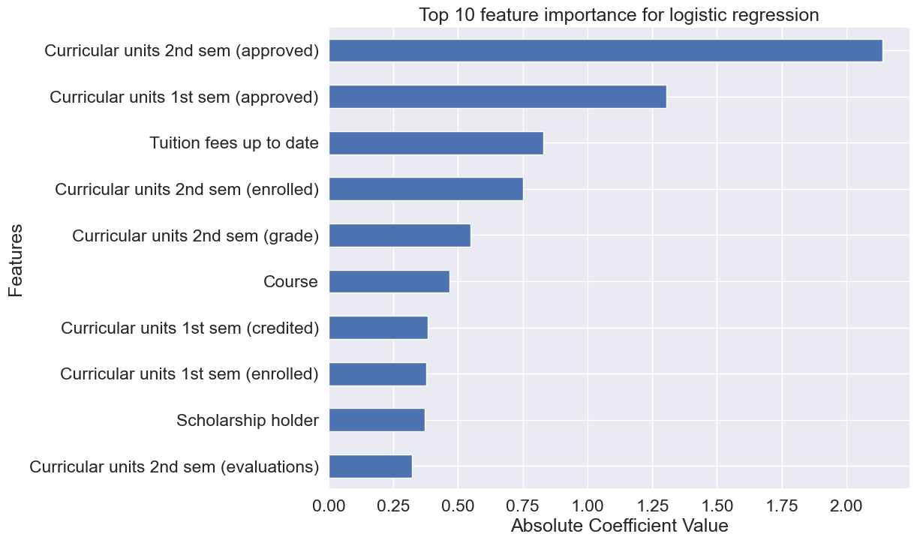
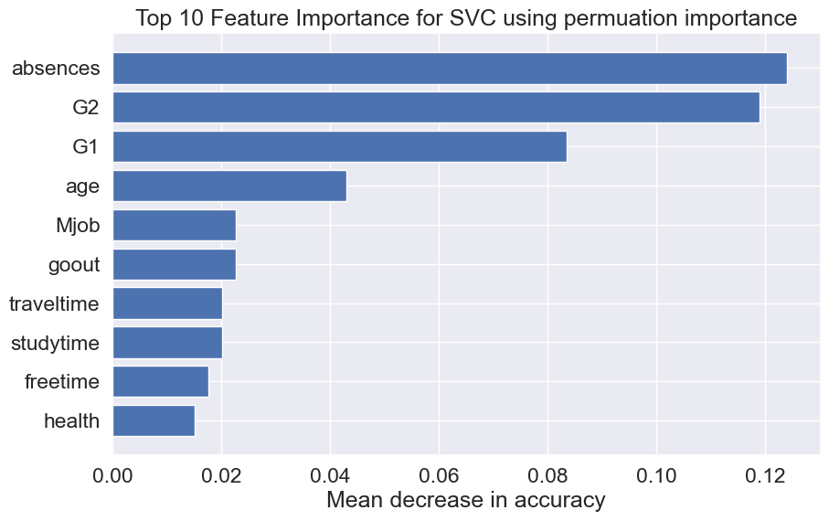
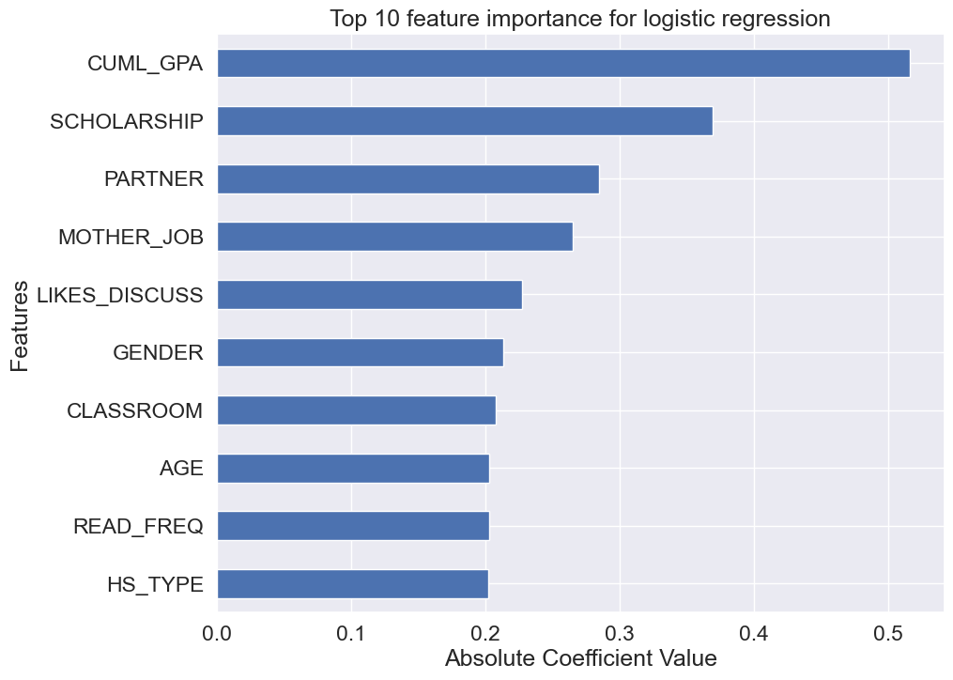
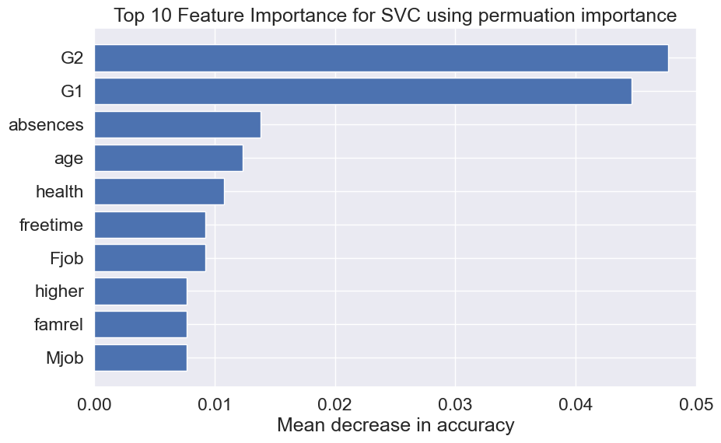
Feature Importances of the 4 best models
Model 1
Model 2
What are the main factors?
1. Academic
2. Socio-economic
3. Social
Model 3
Model 4
Notes:
By understanding which features are most important, educators and the AI system can understand what impacts student performance the most. For instance, if 'Tuition fees up to date' has high importance, it might indicate financial stability is a significant predictor of academic success.
If certain academic-related features, such as 'Curricular units 2nd semester (grade)', are identified as highly important, this suggests that recent academic performance should weigh heavily in personalizing future course recommendations.

Slide 7


User Interface – Tech Stack
As a proof of concept, an interactive user interface was developed to interact with the models trained.
The user interface was made using a python framework called Streamlit.
The UI built allows educators, administrators, and students predict academic outcomes based on academic, socio-economic, demographic, and social features.
There are a total of 4 models to make predictions of various academic outcomes
SQLite3 was used to store the datasets in different tables of a database.

Slide 8
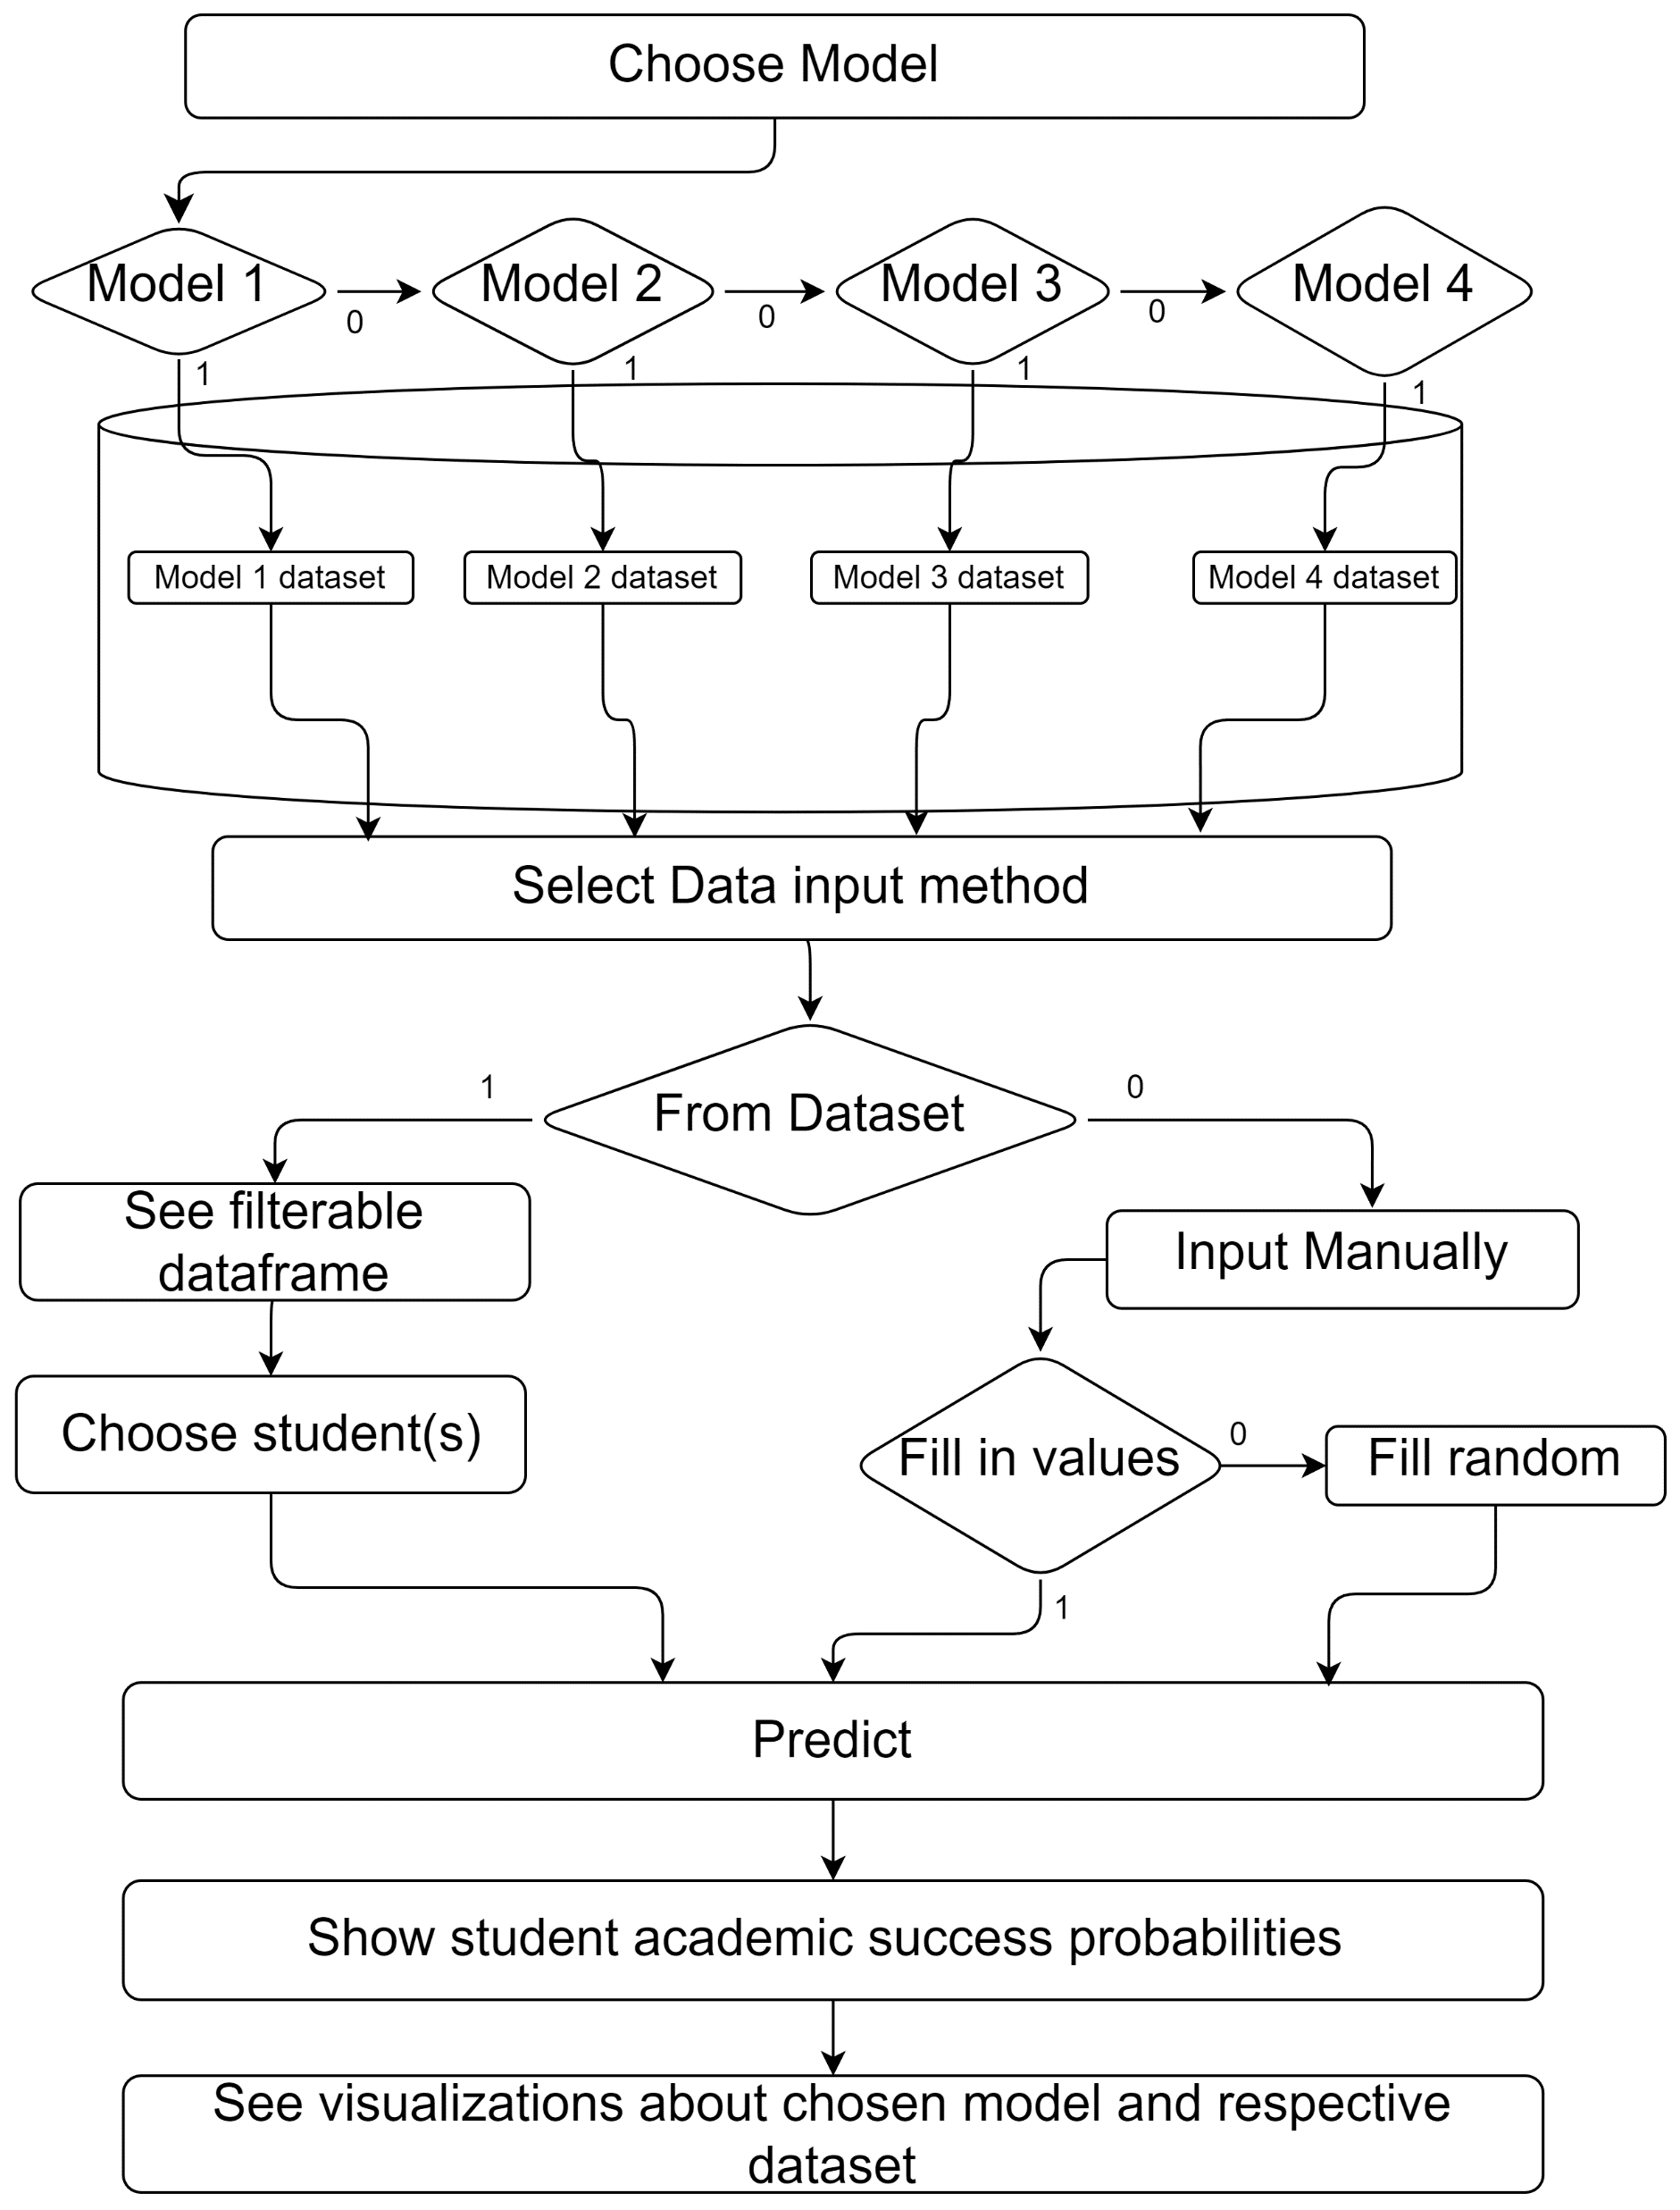
User Interface flow

Slide 9
Implications and use cases
Customized learning paths
Data-driven decision making: resource allocation and curriculum development
Identify at-risk students
Addressing educational disparities
Informing policy development
Future Work and Considerations
Creating our own dataset from KazNU by creating a comprehensive and ethical survey to integrate personalization variables, as done by Nabizadeh, S. et al¹.
Integrate to Univer system to develop a real-time recommendation system.
Collaborate with other universities for more a representative sampling.
Nabizadeh, S., Hajian, S., Sheikhan, Z., & Rafiei, F. (2019). Prediction of academic achievement based on learning strategies and outcome expectations among medical students. In BMC Medical Education (Vol. 19, Issue 1). Springer Science and Business Media LLC. https://doi.org/10.1186/s12909-019-1527-9

Slide 10

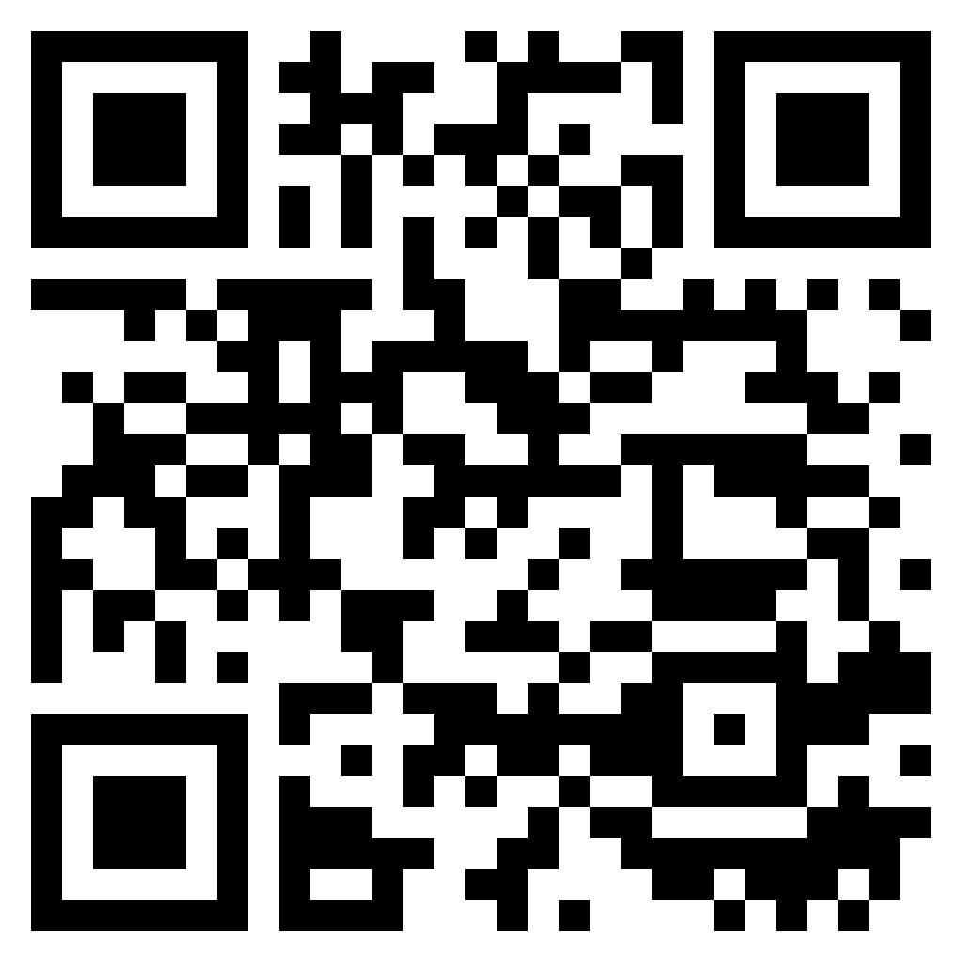
Demonstration
https://academic-success.streamlit.app/

Slide 11
Thank you for your attention! Questions?

